Slide 1
ELEC 3300 Proposal
Ieong, Zi Liang jason (zljieong)
Yim Man Chak (mcyim)

Slide 2
Project Idea
Reinventing remote robot with 3D input

Slide 3
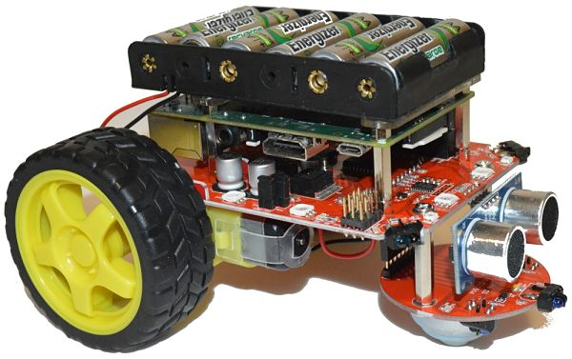
Ideas Behind…
2D input
Traditional robots with 2 wheels are capable of only turn left/right, forward/backward
References:
Right: The Best Raspberry Pi 3 Kits for Robotics
Left: RC King 27Mhz Remote Control, Remote Controller Transmitter Controller Accessories for Kids Ride On Car Replacement Parts

Slide 4
Ideas Behind…
Omni Wheels Robot capable of rotating around Z-axis and forward/backward towards any direction
3D motion input?
References:
Right: How to build an Omni Wheels Robot
Left: Motion-sensing game controllers explained

Slide 5
Project Deliverables
Omni Wheels Robot capable of rotating around Z-axis and forward/backward towards any direction
3D motion input?
🎮
Handheld remote controller with motion detection
🤖
Omni Wheels Robot
with 3 wheels
Bluetooth
References:
Right: How to build an Omni Wheels Robot
Left: Motion-sensing game controllers explained

Slide 6
Project Deliverables
🎮
Handheld remote controller with motion detection
🤖
Omni Wheels Robot
with 3 wheels
Bluetooth

Slide 7
Project Design
Remote 🎮
Robot 🤖

Slide 8
Functional Requirements
Communication
Motion Sensing
Closed loop motion control

Slide 9
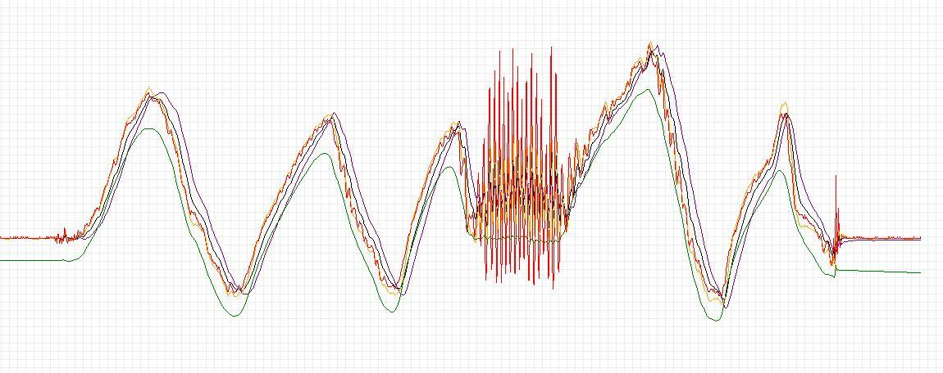
Motion Sensing
🎮
Hardware Used
MPU6050
Known issues:
Gyroscope drifts
Accelerometer unstable
Software solution:
Complementary Filter / Kalmen Filter
Image source: https://robottini.altervista.org/kalman-filter-vs-complementary-filter

Slide 10

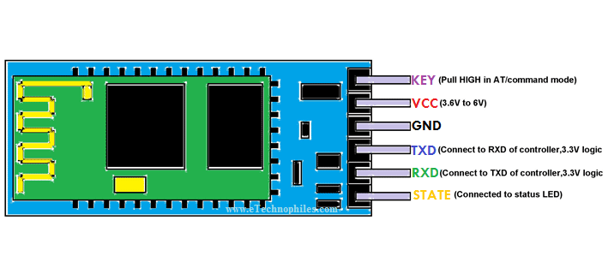
Communication
🎮
🤖
Target: wireless control
Options: WIFI / Bluetooth
Bluetooth is good enough
Consumes less power and computational power
Hardware Used:
HC05
Protocol:
UART

Slide 11
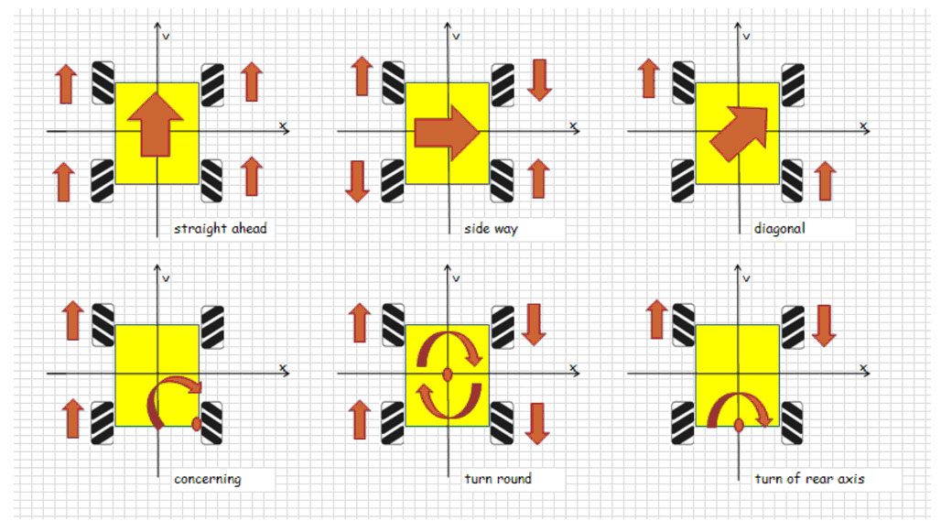
Closed Loop Motion Control
🤖
Mechanical problems:
Each Omni wheel introduce error
Hardware and Software solution:
Encoder
Individual PID control
MPU6050
Global speed control
Image source: https://www.roboteq.com/images/article-images/frontpage/wheel-rotations.jpg

Slide 12
Additional Features
🎮
🤖
Battery
Then it’s truly handheld
Vibration Motor
Alerting user of events, e.g., low battery, car collision
I2C LCD & Buttons
Interaction with user and provide remote and car info
RGB LED
Better user experience
IR pulse sensor
User pulse checking
Battery
No more cable!
3 TOF Sensors
Distance detection for preventing wall collision
6 RGB LEDs
Better user experience
EEPROM
Storing calibration

Slide 13
Challenges
Difficulties & limitations

Slide 14
Difficulties & Limitations
🎮: Control method can be difficult to adapt
🎮: Limited control distance due to short BT coverage
🤖: No camera (difficult for analysis and self-positioning)
🤖: Difficult to evaluate control performance

Slide 15
Thank you!

